Slide 1
Community
Dr. Ayushi Jain
Dept Of Community Physiotherapy
MGM Institute Of Physiotherapy
Chh. Sambhajinagar

Slide 2
Definition
A social group with ‘we feeling’ and ‘living in a given area’— Bogardus
A group of people inhabiting in a given geographic area, sharing a common way of life, working together for certain ends, aware that they belong to the community as well as the larger society.
People will have common interest and activities united together with common living patterns and organised social life.

Slide 3
ELEMENTS OF COMMUNITY (CHARACTERISTICS)
Locality
Regulation of Relations
Dependency
Community Sentiment
Group of people
Permanency
Naturality
Likeness
Wider Ends
Particular name
Legal status
Size of the community

Slide 4
Benefits

Slide 5
Benefits of Community Life
Provides the individual needed security and protection.
It strengthens the unity among people.
Provides for cooperation among the members. It encourages collective forces (efforts) for fulfillment of community’s needs.
Depends on communication system among the members.
Provides the individual with opportunities for the expression of his talents, abilities and personality development.
Provides sense of belongingness. Community life has its own conflicts and contradictions for the individual. Certain times community life has tensions, clashes due to anti-social tendency of man.

Slide 6
Types
Urban community: People living in towns and cities mainly depending on non-agricultural occupations.
Rural community: People living in villages mainly depending on agriculture and other allied occupations.
Tribal community: Living in tribal areas, away from the area of influence of civilization.

Slide 7
Let’s have a debate
Urban community
Rural community

Slide 8
Discuss the following things
Definition
Meaning
Characteristics
Hazards
Remedial measures
Goals

Slide 9
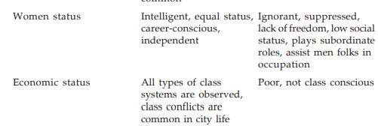
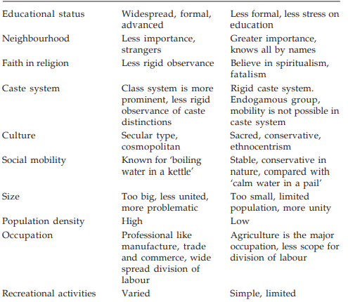

Slide 11
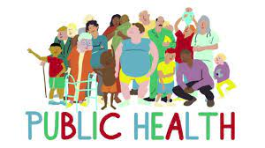
The science and art of preventing disease, prolonging life, and promoting health and efficiency through organised control of communicable infections, the education of the individual in personal hygiene, the organisation of medical and nursing services for early diagnosis and preventive treatment of disease, and the development of social machinery to ensure for every individual a standard of living adequate for the maintenance of health, so organising these benefits as to ensure every citizen to realise his birthright of health and longevity—Winslow

Slide 12
Role of Urban Community in Maintaining Public Health
• Majority of urbanites are educated, belongs to higher socioeconomic status, maintains decent standard of living
• They are conscious of the health, and will take proper measures to prevent the occurrence of communicable diseases by adopting timely immunisation, environmental and personal hygiene, safe drinking water, hygienic food, proper sanitation, etc.
• Public awareness campaigns, mass-media activities were carried out by the health organisation to up-date the knowledge of public
• Implemented various schemes like National Health Programmes, Community Development Programmes
• Urbanites will not encourage their family members to eat unhygienic foods
• Maintains sanitary measures like usages of sanitary latrines, proper disposal of liquid and solid wastes

Slide 13
• Proper ventilation, water purification measures are adopted
• Under goes periodic health check-up after the age of 40 years
• Due to advancement in transport and communication system, the urbanites can reach the medical facility in the need of hour within short span of time
• Due to advancement in scientific technology people will use diagnostic measures even within the house itself eg: Blood sugar level, blood pressure, preg-colour test etc.
• By advancement of communication system like internet, video conference, the health consultation is carried out across the globe and medical measures is suggested within short time
• Higher concentration of medical professionals are distributed within the cities and town will make the urbanites to get medical help much easier and faster

Slide 14
Role of Rural Community in Maintaining Public Health
• Majority of the ruralities are illiterates or having less education and low socio-economic status; but they have the skills which they learn from their ancestors related to health measures
• Ruralities are having the practices like getting up early morning; cleaning the house, worshipping God and going for daily activities
• Cleaning the floor of the house frequently with cow dung helps to prevent microbial growth, thus they believe that cow dung will prevent the spread of communicable diseases
• Planting trees around the house specially neem trees will provide natural aeration

Slide 15
• Ruralities consume more of fresh, natural vegetables and fruits compared to urbanites, who consume caned, processed foods; this itself will maintain ruralities health
• Low density population, more leisure time for the ruralities facilitate to enjoy nature
• As ruralities are mostly agriculturist having less stressful life and keeping them away from stressful stimuli and prevents from psychosomatic diseases
• Ruralities will develop and maintain effective, intimate social relationships which will prevent the occurrence of social problems.

Slide 16
Role of Community in Determining Beliefs, Practices and Home Remedies in Treatment
Tattoo
Snake bite
Colostrum
Papaya

Slide 17
Home remedies

Slide 18
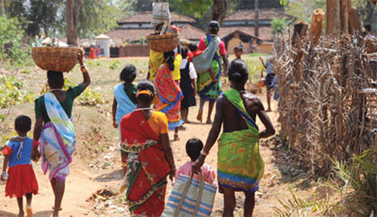
tribe
‘Group of families bearing a common name, speaking a common dialect, occupying or professing to occupy a common territory and is not usually endogamous though originally it might have been so’—Imperial Gazette of India

Slide 19
CHARACTERISTICS OF TRIBE
Definite Common Topography
Consciousness of Unity
Common Language
Endogamous
Ties of Blood Relationship
Experience of Need for Protection
Political Organisation
Importance of Religion
Common Culture
Indian tribes

Slide 20
Tribal problmes
Problem of geographic separation
Economic problems
Cultural problems
Social problems
Educational problems
Health problems
Lack of transportation and communication facilities

Slide 21
Tribal Welfare Activities for ignorance, illiteracy and poverty
Constitutional safeguard—article 15 provides equal rights and opportunities to all the citizens of nation including tribal without any discrimination, article 16 shows reservation in employments for Girijans.
320 and 335 articles, seats were reserved for legislations, 330, 332 and 334, describes the tribals can make property and enjoy it in any part of the country, article 275, funds related to tribal welfare activities, 338 empowers the President of India to appoint commissioner and other official agencies for implementation of tribal welfare activities.

Slide 22
Tribal Welfare Activities for ignorance, illiteracy and poverty
• Economic facilities—tribal sub-plans, integrated tribal development projects for economic improvement of the tribals, loans will be given for the purchase of necessity things in life.
• Education facilities—schools are established in some tribal areas, for tribal students concessions like free tuition, stipend, scholarship, supply of stationary equipment, midday meal, relaxation for entry into various courses, and for job opportunities.

Slide 23
Tribal Welfare Activities for ignorance, illiteracy and poverty
• Medical facilities—establishment of hospitals, mobile units in tribal areas, conducting free medical camps, awareness campaigns to inspire the tribal people for effective utilisation of medical services.
• Carrying out research activities—permission to conduct intensive studies related to culture, customs, and identification the problems of tribal people, sanctioning of funds for tribal welfare activities

Slide 24
Thankyou

